Slide 1
Gig Images
Do's and Don'ts

Slide 2
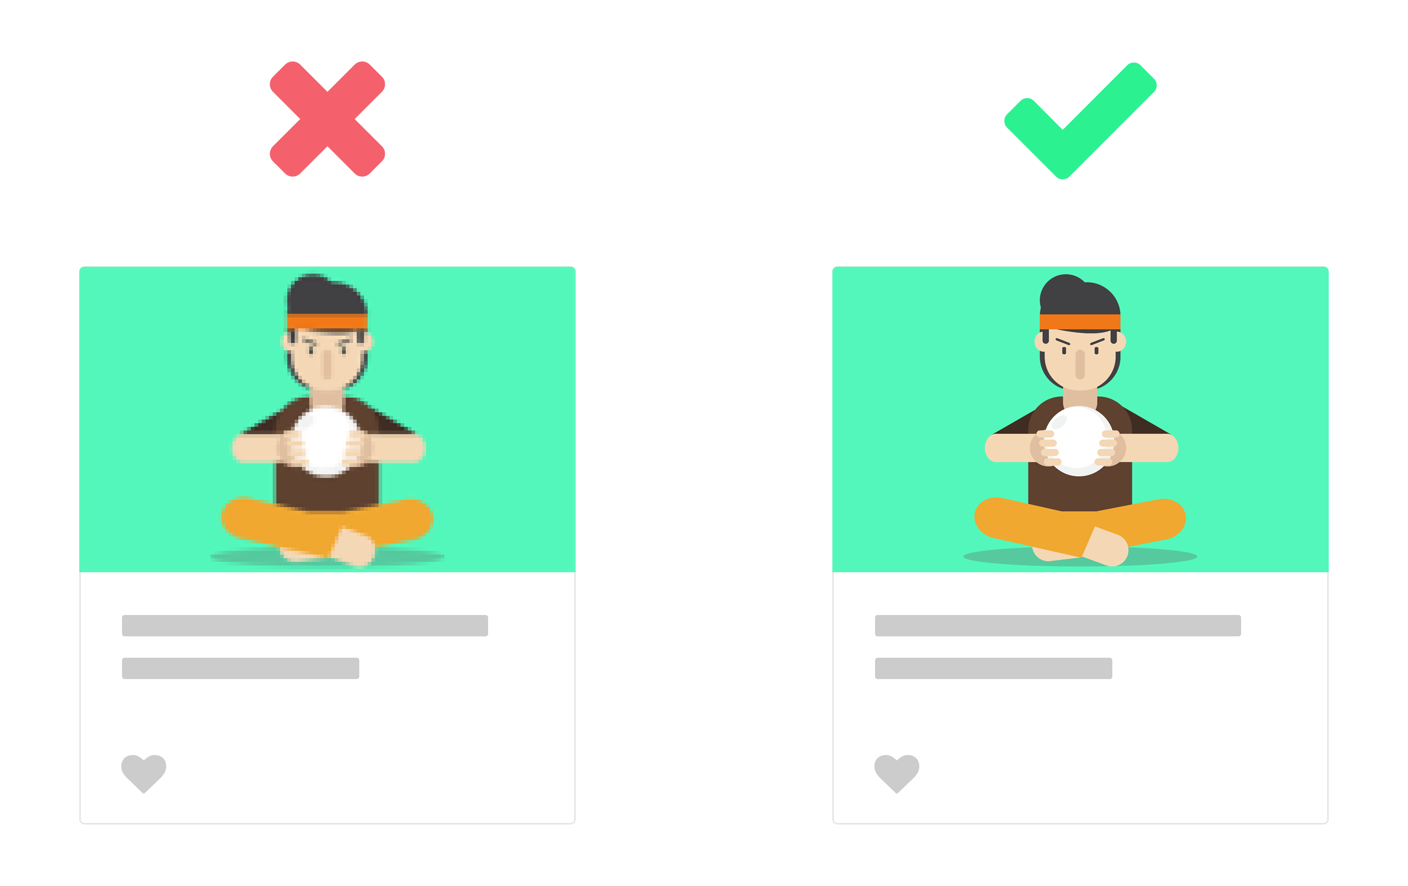
Quality
Don’t use pixelated images. Pixelated images are often low-quality, and potential buyers may believe this means you offer a low-quality Gig. Use high-res images for the best results

Slide 3
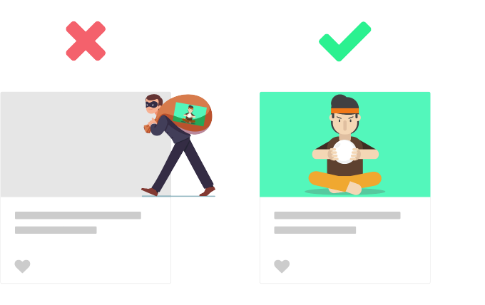
Copyrights
Don’t use stock images or other people’s work if you don’t have usage rights

Slide 4
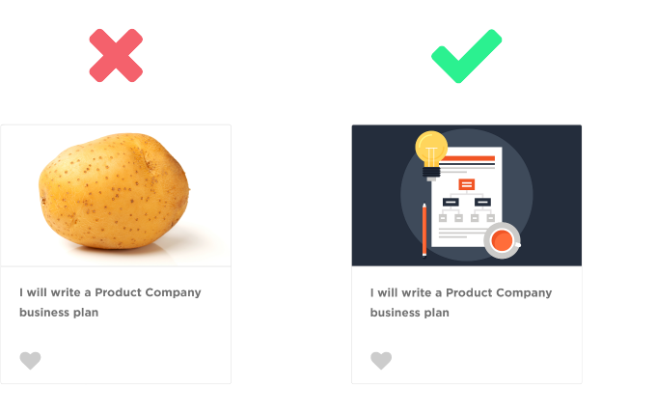
Relevancy
Make sure your Gig image is related to the service you are offering. Irrelevant images compromise your Gig’s credibility.

Slide 5
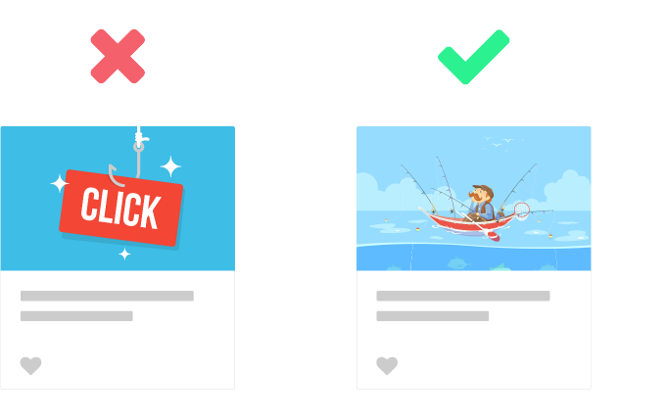
Clickbait
Don’t use clickbait. Using images for the sake of clicks can cause frustration and may even put your Gig at risk with Fiverr’s integrity team and lower your ranking.

Slide 6
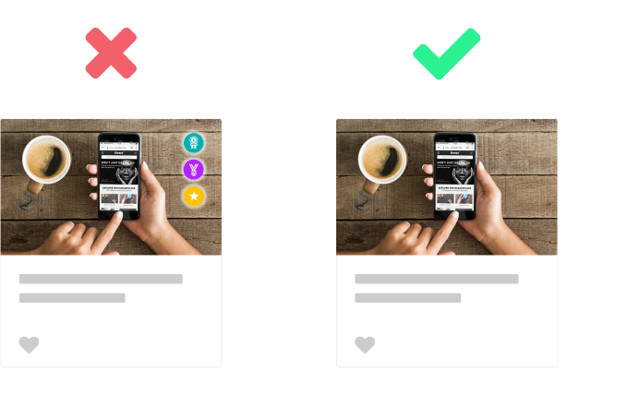
Badges
Don’t put Fiverr badges or rewards on your profile or Gig image.

Slide 7
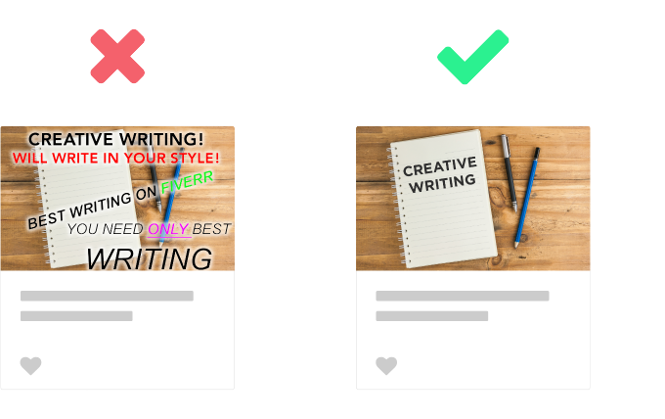
Text
Don’t use too much text on an image. Keep the space clean so your primary message will pop.

Slide 8
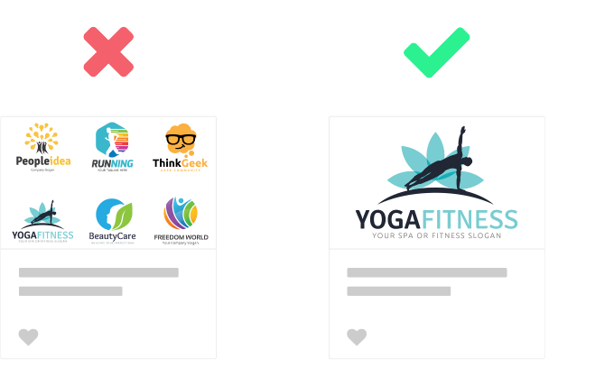
Density
Don’t overcrowd with images, either.

Slide 9
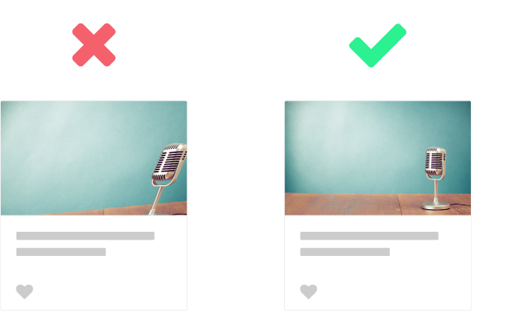
Proportions
Use the right image proportions. Don’t stretch, rotate, or use images that are too small. The recommended image size is at least 690 x 426px.

Slide 10
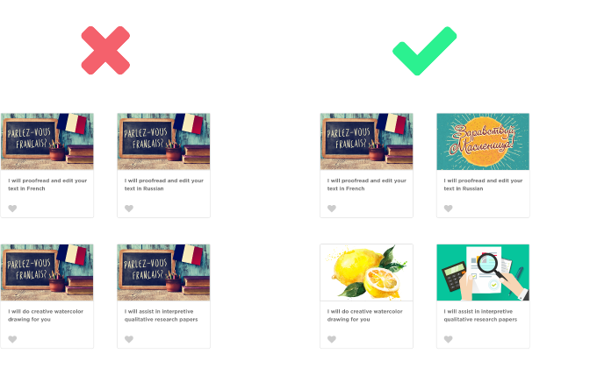
Uniqueness
If you own more than a single Gig, be sure to choose a different image to each one. This will ensure buyers can find what they need

Slide 11
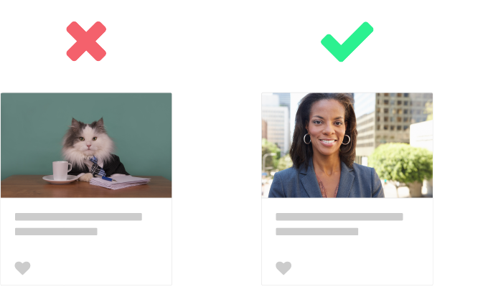
Authenticity
If you chose to use your personal photo make sure it’s truly representative. Show your real face, preferably from a front-facing angle to communicate trust

